Slide 1
St Cuthbert’s Catholic
First School
Key Stage 1 SATs
Parent Information 2023

Slide 2
Aims:
Explanation of what Key Stage 1 SATs are.
Give you an understanding of the format of the tests.
Explain how tests results affect judgements on children’s attainments.
Explain SATs revision club.
Recommend how you can help your child at home.

Slide 3
What are SATs?
At the end of Year 2, children in England sit national tests in the following subjects, the results are used to measure the school’s performance:-
*English – Reading
*English – Grammar, Punctuation & Spelling
*Mathematics – Arithmetic & Reasoning
These tests reflect the updated national curriculum and are marked using the current grading system, which now replaces levels.

Slide 4
What are SATs? – Continued
Key Stage 1 SATs take place nationally in the month of May.
There are no tests administered in science.
All tests are internally marked.
As in recent years, writing will be teacher assessed internally and moderated in the year group.
Testing is low key to ensure children are not worried or anxious about taking them.

Slide 5
Overview of test papers:
Reading Paper 1 - consists of a combined reading prompt and answer booklet. The test takes approximately 30 minutes.
Reading Paper 2 - consists of an answer booklet and a separate reading booklet. It contains more challenging texts than Paper 1. The test takes approximately 40 minutes.
Maths Paper 1 - arithmetic consists of a single test paper and takes approximately 20 minutes.
Maths Paper 2 - reasoning consists of a single test paper and takes approximately 35 minutes. The paper includes a practice question and 5 aural questions. After the aural questions, the time allowed for the remainder of the paper should be around 30 minutes.
GPS Paper 1 - spelling consists of a test transcript to be read by the test administrator and an answer booklet for pupils to write 20 spellings. The paper takes approximately 15 minutes.
GPS Paper 2 - questions is a combined question and answer booklet focusing on pupils’ knowledge of grammar, punctuation and vocabulary. The paper takes approximately 20 minutes.

Slide 6
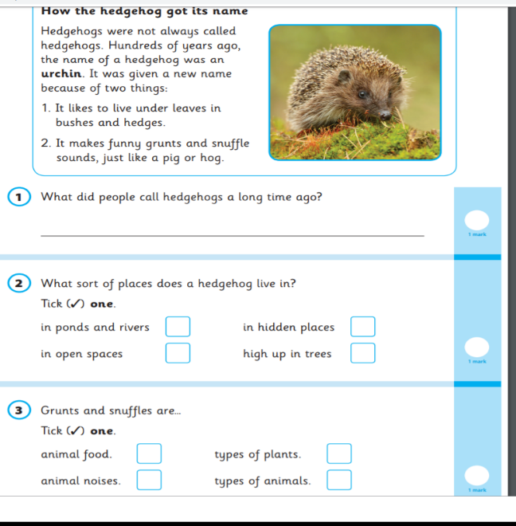
Reading Paper 1 Example Page:

Slide 7
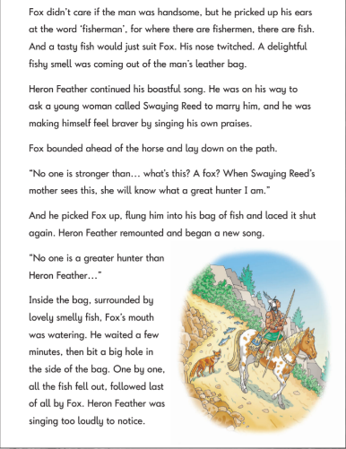
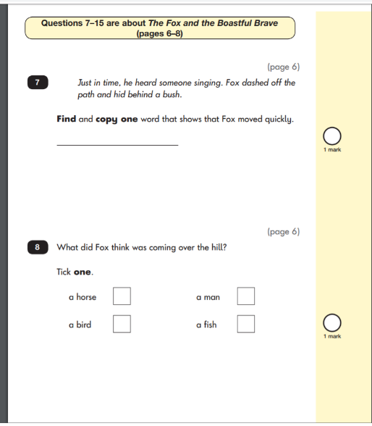
Reading Paper 2 Example Page:

Slide 8
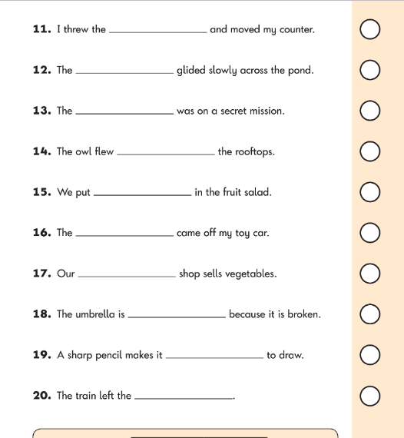
English – Spelling Example Page:

Slide 9
English – Grammar Example Page:

Slide 10
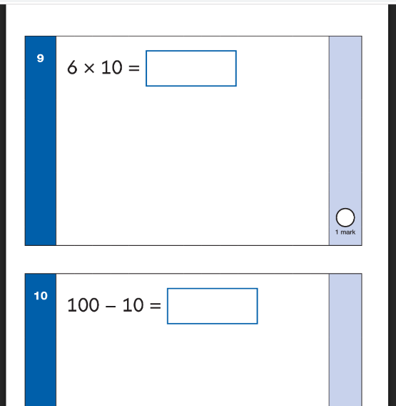
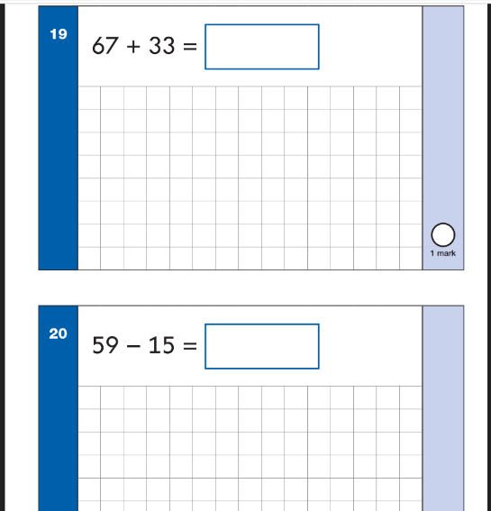
Maths Paper 1 (Arithmetic) Example Page:

Slide 11
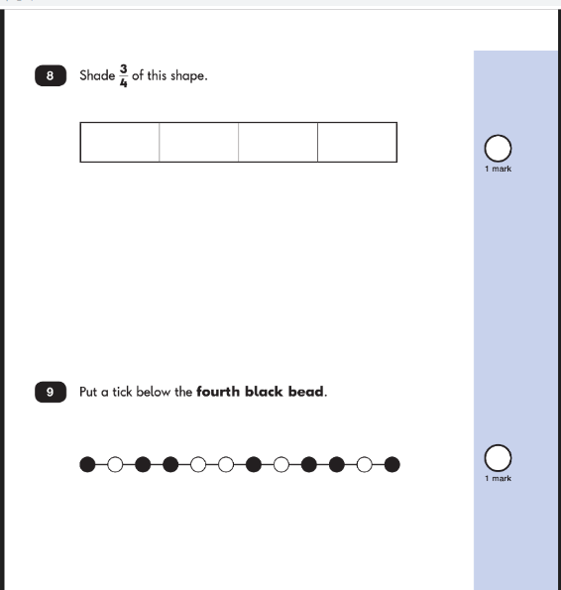
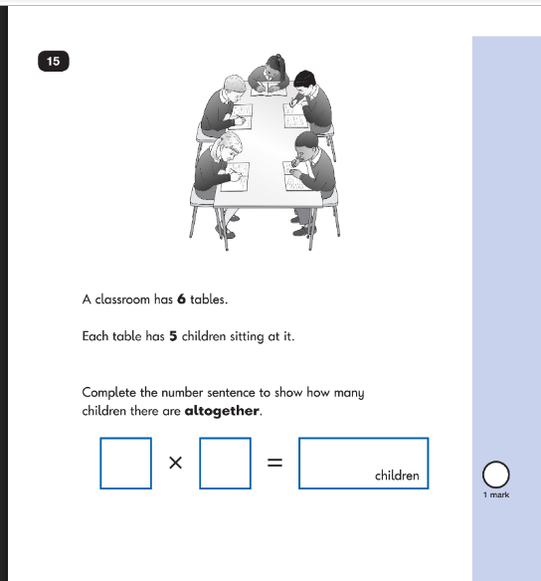
Maths Paper 2 (Reasoning) Example Page:

Slide 12
Teacher Assessment / Results:
KS1 SATs tests are one part of evidence towards the whole teacher assessment.
They are marked in school, and an overall grading based on the whole year’s work will be made.
The results of the SATs tests are reported to the Local Authority.
Moderation often takes place to ensure consistency across schools.

Slide 13
How can you help at home?
First and foremost, support and reassure your child that there is nothing to worry about and they should always just try their best.
Help your child with reading, listen to them read and focus on bringing out a ‘love of reading’. Also reading stories to your child allows them to develop language, listening skills and comprehension. Encourage making predictions of what might happen next.
Help your child with writing, support with weekly spellings. Write together to make shopping lists and letter writing.
Help your child with maths, play times table games. Encourage them to help with cooking, weighing and measuring ingredients. Work out what time it is together. Provide opportunities for your child to pay for things in a shop, to work out how much things cost and how much change will be needed.

Slide 14
Useful Websites:
https://www.bbc.co.uk/bitesize
https://www.ictgames.com/mobilePage/index.html
https://whiterosemaths.com/advice-and-guidance#start
https://nrich.maths.org/maths-at-home
https://mathszone.co.uk/
https://www.topmarks.co.uk/maths-games
https://www.topmarks.co.uk/maths-games/hit-the-button

Slide 15
Thank you for reading!
The tests are part of the process.
We use the data from the tests to challenge or confirm our overall teacher assessment.
If you have any further questions, please do not hesitate to ask Miss Thompson.

